Slide 1
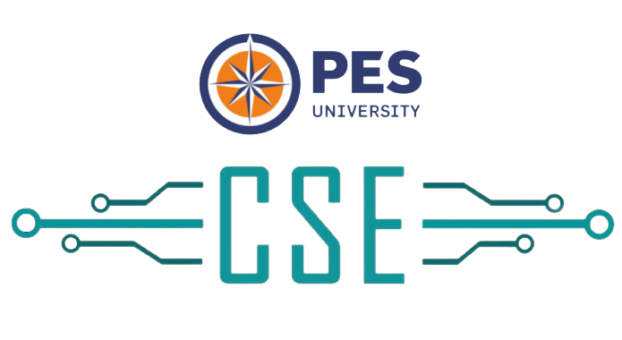

Paper Talk Episode 4 Building Foundation Models using Transformers
Aditeya Baral

Slide 2

About Me
Cisco Webex*
Big Data Analytics, Webex Media Quality
Webex Message AI
Intel Research (VSG) - Applied Research Scientist Intern
Center for Cloud Computing & Big Data, PESU - UG Researcher
Publications
AAAI MAKE 2022
ICNLSP 2021
IEEE CONIT 2021
Interests
Representation Learning for language understanding
Foundation models and Multi-Modal learners
Low-resource or under-represented NLP
aditeyabaral.github.io

Slide 3
Overview of Topics
What is a Foundation Model and Introduction to Transfer Learning
Representation Learning – What, Why and How?
Overview of some NLU algorithms
CalBERT and MWP-BERT
Hands-on Exercise
Conclusion

Slide 4
Foundation Models
If you can drive a BMW, can you also drive Mercedes?
Do you know the values of the constants – speed of light, acceleration due to gravity?
Do you know which biological component is called the powerhouse of the cell?

Slide 5
Foundation Models
If you own and can drive a BMW, can you also drive Mercedes?
Can you also drive an autorickshaw? A bus? A tractor?
If you can drive a manual car, can you drive an automatic?
Do you know the values of the constants – speed of light, acceleration due to gravity?
Do you also know the value of Plank’s constant? Newton’s Gravitation constant? 1 Mole?
Do you know which biological component is called the powerhouse of the cell?
Which component is called the kitchen of the cell?

Slide 6
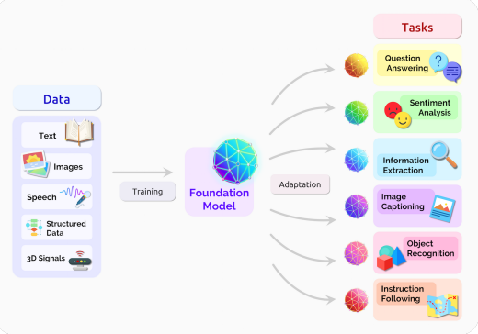
Foundation Models
Built on foundational learning – just the way humans do!
Learn concepts A, B and C and apply them to A, B, C, as well as D, E, F…
Learn science → Physics, Chemistry and Biology → Quantum Physics
Learn numbers → add/sub/mul/div → expressions → algebra → calculus
Trained on gigabytes of different forms of data ranging different topics
Ensures satisfactory performance on all tasks without fine-tuning
Compromises great performance on any single task (achieved with fine-tuning)
Models like GPT-4 are trained on academia, literature, science, legal etc
Use foundation models as stepping-stones
Use transfer learning to improve performance on singular tasks
Go from a generic model to a specialised model
Usually created on non-specific tasks
Mostly unsupervised or self-supervised
On the Opportunities and Risks of Foundation Models, CRFM, Stanford Institute for HAI

Slide 7
Transfer Learning
Application of foundation models to different downstream tasks
Downstream task could be similar or dissimilar to upstream tasks
Study for an exam and then apply it on questions
A model for summarization can be fine-tuned for paraphrasing or question-answering
Two stages
Pre-training
Build foundation model
Use large amounts of data
Takes more time and compute
Fine-tuning
Build task-specific model
Use small amounts of data
Takes less time and compute

Slide 8
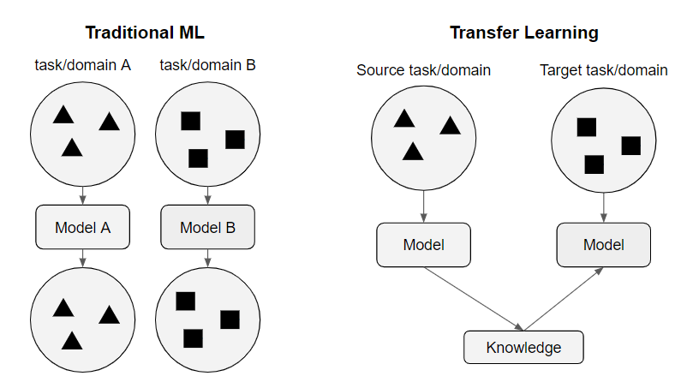
Transfer Learning
Example: Summarization of legal articles
Step 1: Pre-train on large amounts of text data
Step 2: Fine-tune on medium amount of legal text data
Step 3: Fine-tune for generating summaries
Fine-tuning comprises 2 steps
Domain adaptation – fine-tune foundation model on the same domain as target domain
Task adaptation – fine-tune foundation model on specific tasks
Sometimes, both steps can be accomplished in a single step!
Sometimes the same model is used for pre-training and fine-tuning
Freeze the embedding/initial layers
https://slds-lmu.github.io/seminar_nlp_ss20/introduction-transfer-learning-for-nlp.html

Slide 9
Transfer Learning
Types/sub-fields
Zero-Shot (or, no transfer learning)
One-Shot
Few-Shot
Knowledge Distillation
Advantages
Requires less data to model your task, faster to adopt different tasks
Teaching someone who knows to drive a car to drive a bus is easier than teaching someone who cannot drive at all
Higher performance on targeted tasks
Less compute
Disadvantages
“Catastrophic Forgetting”
Domain suitability - avoiding negative transfer

Slide 10
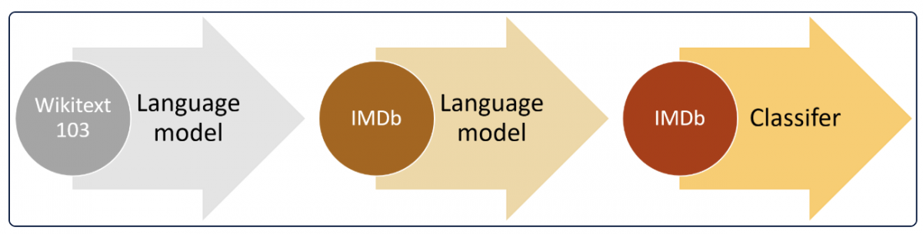
Transfer Learning and NLP
NLP made transfer learning popular
Almost all modern-day NLP is based on transfer learning – ChatGPT/GPT-4, Bard, LLaMa
Large amount of text data is available for generic uses, but specific uses have less data
Build basic language understanding and then adapt to domain/task
Main goal of transfer learning – better language understanding
Create models which understand better, and hence perform better
Tougher than modelling language/linguistic form
Learn representations for language – word embeddings that capture relationships and properties

Slide 11
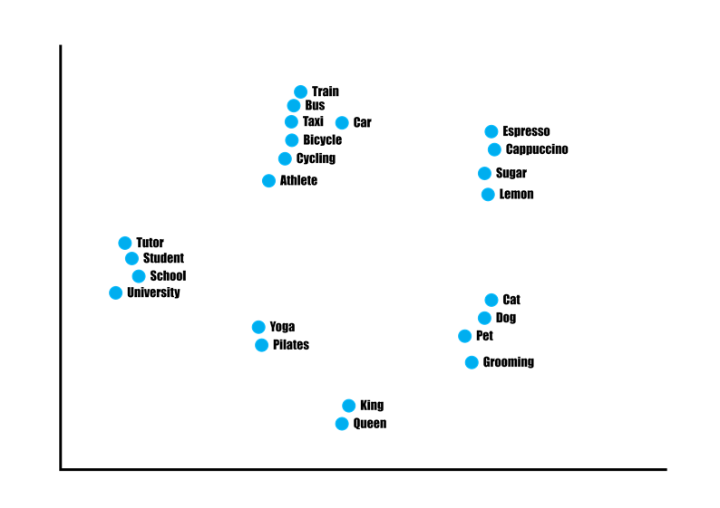
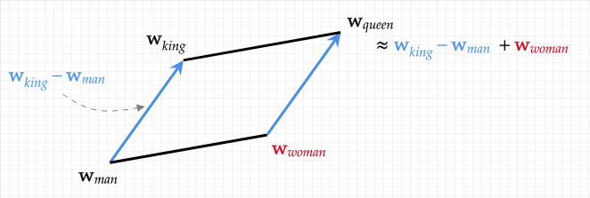
Representation Learning
Represent characters, words, sentences in a numeric form
Convert a word to an n-dimensional vector
Each dimension represents a hidden characteristic/feature of that word
Vector lies in a semantic space of all words in the vocabulary
Similar vectors lie closer (angle between them is 0)
Vectors have relationships with other vectors and can be operated on
King – man + woman = Queen (Word2Vec, 2013)
Primitive approaches
Bow, Tf-Idf
Preliminary Neural approaches
Word2Vec, fastText, GloVe
Modern LM approaches
LSTM - ELMo, ULMFiT
Transformer - BERT

Slide 12
Representation Learning Approaches
Bidirectional contextual learning using Language Modelling
A B ___ D E - Masked Language Modelling (MLM)
__ __ C __ __ - identify correct context
Next Sentence Prediction (NSP)
Learn if a sentence is followed by another
Sentence 1 [SEP] Sentence ?
Word2Vec was based on MLM, but it used context windows, not sentences
fastText did the same at the character level and then averaged embeddings for a word
BERT uses 2 approaches for pre-training – MLM + NSP
BERT variants: RoBERTa (only MLM), DistilBERT (KD using pre-trained BERT), XLM-RoBERTa (multilingual)
Current approaches for representation learning need MLM (and/or NSP) along with other specialised steps for domain adaptation

Slide 13
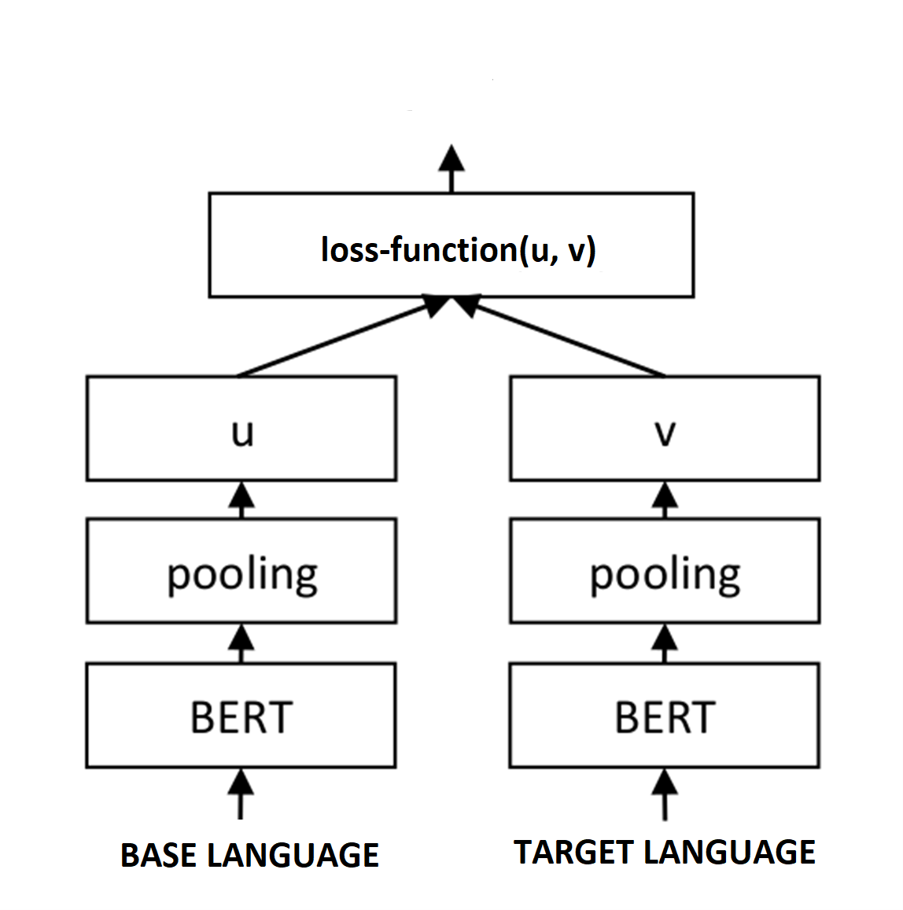
CalBERT
Code-mixed languages are complex and are prevalent in multilingual communities
Multiple forms of the same word
Lack of abundant clean and usable data
Normal Transformers do not perform well on code-mixed tasks
Two proposed techniques to learn from code-mixed data
Accounts for context as well as morphological mutations
Knowledge Distillation: “Adapt” representations in English to Hinglish
Pre-training: End-to-end pre-training using different tasks
MLM
NSP
Alignment with transliteration
Semantic similarity with translation and transliteration
Applications
KD approach achieved SOTA on 2 code-mixed benchmarks, beating existing approaches by 9%
Models are task-agnostic, thus can be applied to any code-mixed task
CalBERT - Code-mixed Adaptive Language representations using BERT

Slide 14
MWPBERT
A recent pre-training technique to learn representations of Math Word Problems (MWPs)
MWPs are not like normal text
Need to learn information about operands, operators and computations
Representations need to also account for the validity of MWPs
MWPBERT injects knowledge about numbers and solvability to existing BERT pre-training
MLM
Operand counting
Operand data type prediction
Answer data type prediction
Operand and Answer data type compatibility
Answer magnitude comparison
Operation prediction
Equation tree distance prediction
Applications
Significant improvement over ordinary BERT as well as other methods for MWP solving and generation
MWP-BERT: Numeracy-Augmented Pre-training for Math Word Problem Solving

Slide 15
Hands-on Exercise
Problem
Ideate different tasks to learn from a structured conversation (like WhatsApp)
You can use any data which WhatsApp provides
messages, contact info, group info
Should learn accurate representations for entities, topics and develop basic language understanding

Slide 16
Conclusion
Foundation models can be used to create models to tackle multiple tasks
Using transfer learning, foundation models can be fine-tuned for different domains or tasks
Domains/Tasks can be similar to pre-training stage
Improves performance, requires lesser data and compute
Primarily used in NLP for language understanding
Representation learning is used to build NLU
Modern methods use BERT-based architectures
Leverage multiple pre-training tasks to adapt to specialised use-cases
If tasks are chosen correctly, it is possible to model almost everything
Code-mixed languages
Math word problems
WhatsApp conversations
Representations are then used for other predictive tasks

Slide 17
Thank You

